Slide 1
Digital Advertising
To auction “keywords” or not to auction that is the question Gruppe 2

Slide 2
Agenda
Einführung / «Business Case» (MAC)
Data (PK)
Generierung
Normalisierung
Code
Übersicht / Reward / Learning (RB)
Optimierung (Tensorboard / Optuna) (PZ)
Analyse
Hyperparameter_tuning script (EO)
Tensorboard-analyzer / Visualization-ad_performance scripts (EO)
Data comparisons / Conclusions (EO)
Lessons-Learned / Herausforderungen (all)

Slide 3
Einführung – Business Case (MAC)
Einführung
Datenbasierte Budgetallokation (10% des vorhandenen Bargeldes) dank Einsatz von KI bzw. Reinforcement Learning
Von der Datenaufbereitung via Modell-Training zur fundierten Analyse und Verständnis
Business Case
Unter der Annahme, dass (brauchbare) Daten vorliegen, rechnen wir mit einer Umsetzungszeit von 3-4 Monaten
Danke einer Effektivitätssteigerung des ROAS um 20% erhalten wir einen positiven ROI nach 12 Monaten
Mögliche Herausforderungen / Abhängigkeiten
Messbarkeit / Zuordnung der Effektivitätssteigerung
Produktions- / Lieferzeiten
Sonstiges (z.B. Landingpage-Qualität, andere Keywords …)

Slide 4
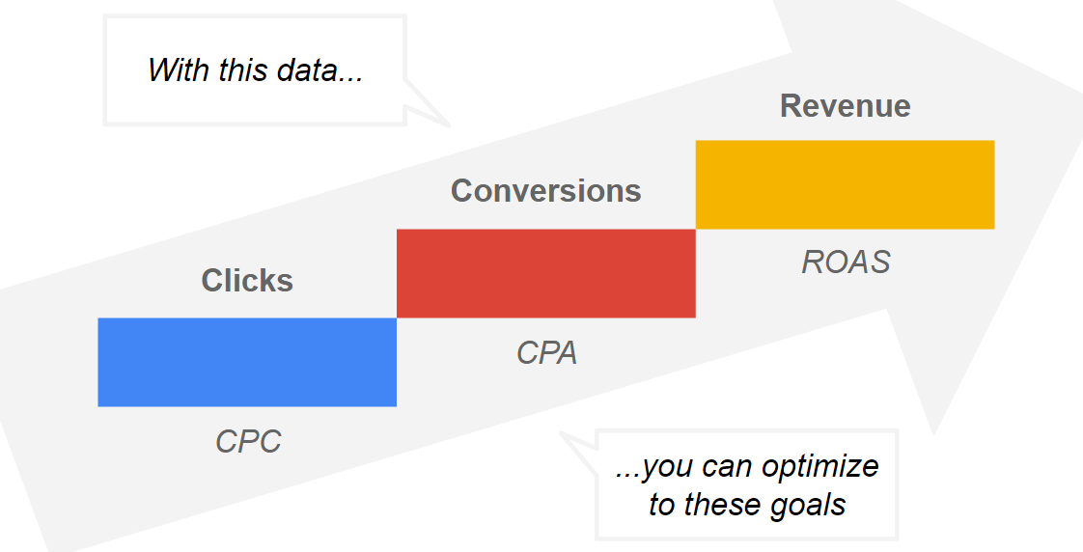
Optimizing is all we need
Wir optimieren den Umsatz, der durch Werbeausgaben generiert wird, im Verhältnis zu den Kosten dieser Werbung.

Slide 5
Agent
Zustand (state (S_{t}))
Vorhandenes «Bargeld» (cash)
«Holdings» - aktive keywords
keyword
competitiveness
difficulty_score
organic_rank
organic_clicks
organic_ctr
paid_clicks
paid_ctr
ad_spend
ad_conversions
ad_roas
conversion_rate
cost_per_click
cost_per_acquisition
previous_recommendation
impression_share
conversion_value
done, terminated, truncated
Aktion (action (A_{t}))
1 Keyword kaufen/bieten oder nichts tun
Belohnung (reward (R_{t}))
ROAS-basiert: ad_roas → maximiere Return on Ad Spend
Kosteneffizienz: ad_conversions / ad_spend → maximieren Conversions pro Ausgabeeinheit
Kombination: 0.6 * ad_roas + 0.4 * organic_clicks → Vergangene Investition zahlt sich aus
Nur «Organisches» Ranking: organic_ctr → Vergangene Investition zahlt sich aus
reward (R_{t+1})
Umgebung
action (A_{t+1})
state (S_{t+1})

Slide 6
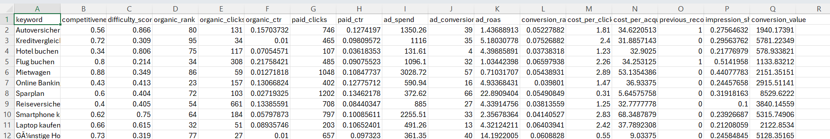
Daten (PK)
Suche nicht zielführend
Shopping Mall Paid Search Campaign Dataset
PPC Campaign Performance Data
Generierung (mit ChatGPT)

Slide 7
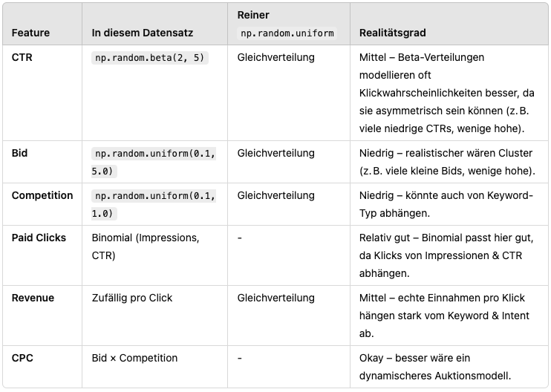
Daten

Slide 8
Code –Dateien (RB)
digital_advertising.py - Deep Reinforcement Learning Module
hyperparameter_tuning.py - Hyperparameter tuning mit Optuna
visualize_ad_performance.py - Leistungsvisualisierung
tensorboard-analyzer.py - Trainingsanalyse
analyze_raw_data.py - Interaktiver Rohdatenexplorer

Slide 9
Code – digital_advertising.py
Daten laden und in Training und Test aufteilen
Custom Environment erstellen
specs
_reset
_step
_compute_reward
Policy erstellen
Trainingsloop mit integrierter Verifikation mit Test und speichern des besten Models
Vorhersagen (Inference)
Speichern der Werte in Tensorboard

Slide 10
Code Custom Environment Specs
Unsere Environment hat folgende Specs:
self.num_features = len(feature_columns)
self.num_keywords = get_entry_from_dataset(self.dataset, 0).shape[0]
self.action_spec = OneHot(n=self.num_keywords + 1) # select which one to buy or the last one to buy nothing
self.reward_spec = Unbounded(shape=(1,), dtype=torch.float32)
self.observation_spec = Composite(
observation = Composite(
keyword_features=Unbounded(shape=(self.num_keywords, self.num_features), dtype=torch.float32),
cash=Unbounded(shape=(1,), dtype=torch.float32),
holdings=Bounded(low=0, high=1, shape=(self.num_keywords,), dtype=torch.int, domain="discrete")
),
step_count=Unbounded(shape=(1,), dtype=torch.int64)
)
self.done_spec = Composite(
done=Binary(shape=(1,), dtype=torch.bool),
terminated=Binary(shape=(1,), dtype=torch.bool),
truncated=Binary(shape=(1,), dtype=torch.bool)
)

Slide 11
Code Custom Environment - _step
Holt die gewählte Action aus dem TensorDict
Aktualisiert den State (Geld, welches Keyword wir kaufen)
Berechnet den Reward
Prüft, ob wir fertig sind
Erhöht den aktuellen Schritt Index
Aktualisert TensorDict mit den aktuellen Werten und gibt den nächsten State gemäss TorchRL Vorgaben zurück
Notes:
The function performs the following steps:
1. Extracts the action from the input tensor dictionary.
2. Determines the index of the selected keyword.
3. Retrieves the current entry from the dataset based on the current step.
4. Updates the holdings based on the selected action.
5. Calculates the reward based on the action taken.
6. Advances to the next time step and checks for termination conditions.
7. Retrieves the next keyword features for the subsequent state.
8. Updates the observation state with the new keyword features, cash balance, and holdings.
9. Updates the tensor dictionary with the new state, reward, and termination status.
10. Returns the updated tensor dictionary containing the next state, reward, and termination status.

Slide 12
Code Custom Environment – _step
TorchRL: Aktueller State in SensorDict, neuer State als Rückgabewert
# tensordict is used from EnvBase later on, so we add the current state here
tensordict["done"] = torch.as_tensor(bool(terminated or truncated), dtype=torch.bool, device=self.device)
tensordict["observation"] = self.obs
tensordict["reward"] = torch.tensor(reward, dtype=torch.float32, device=self.device)
tensordict["step_count"] = torch.tensor(self.current_step-1, dtype=torch.int64, device=self.device)
tensordict["terminated"] = torch.tensor(bool(terminated), dtype=torch.bool, device=self.device)
tensordict["truncated"] = torch.tensor(bool(truncated), dtype=torch.bool, device=self.device)
# next as return value is also used by EnvBase and later added to tensordict by EnvBase
next_obs = TensorDict({
"keyword_features": next_keyword_features, # next pki for each keyword
"cash": cash_normalized.clone().detach(), # Current cash balance
"holdings": self.holdings.clone()
}, batch_size=[])
next = TensorDict({
"done": torch.tensor(bool(terminated or truncated), dtype=torch.bool, device=self.device),
"observation": next_obs,
"reward": torch.tensor(reward, dtype=torch.float32, device=self.device),
"step_count": torch.tensor(self.current_step, dtype=torch.int64, device=self.device),
"terminated": torch.tensor(bool(terminated), dtype=torch.bool, device=self.device),
"truncated": torch.tensor(bool(truncated), dtype=torch.bool, device=self.device)
}, batch_size=tensordict.batch_size)
return next

Slide 13
Code – Custom Environment _compute_reward
Ziel: Bester "Return on Ad Spend (ROAS)"
def _compute_reward(self, action, current_pki, action_idx, ad_roas):
"""Compute reward based on the selected keyword's metrics"""
adjusted_reward = 0 if action_idx < self.num_keywords else 1 # encourage the agent to buy something
if ad_roas > 0: # log(0) is undefined
adjusted_reward = np.log(ad_roas) ## Adjust reward based on ad_roas performance, scale it with log
missing_rewards = []
# Calculate the ad_roas we did not get because we chose another keyword
for i in range(self.num_keywords):
sample = current_pki.iloc[i]
if action[i] == False:
missing_rewards.append(sample["ad_roas"])
# Adjust reward based on missing rewards to penalize the agent when not selecting keywords with # high(er) ROAS
# clipping reduces the variance of the rewards
return np.clip(adjusted_reward - np.mean(missing_rewards) * 0.2, -2, 2)

Slide 14
Code Policy
Wir brauchen die Policy für Training, Test und Inference
def create_policy(env, feature_dim, num_keywords, device):
action_dim = env.action_spec.shape[-1]
total_input_dim = feature_dim * num_keywords + 1 + num_keywords # features per keyword + cash + holdings
# Create the flattening module to combine our observation into one vector
flatten_module = TensorDictModule(
FlattenInputs(),
in_keys=[("observation", "keyword_features"), ("observation", "cash"), ("observation", "holdings")],
out_keys=["flattened_input"]
)
value_mlp = MLP( # Create the value network
in_features=total_input_dim,
out_features=action_dim,
num_cells=[256, 256, 128, 64], # Deeper and wider architecture
activation_class=nn.ReLU # ReLU often performs better than Tanh
)
value_net = TensorDictModule(value_mlp, in_keys=["flattened_input"], out_keys=["action_value"])
# Combine into the complete policy
policy = TensorDictSequential(flatten_module, value_net, QValueModule(spec=env.action_spec))
return policy.to(device)

Slide 15
Code Training Loop
Normaler TorchRL Trainingsloop
exploration_module = EGreedyModule(
env.action_spec, annealing_num_steps=100_000, eps_init=exploration_eps_init, eps_end=exploration_eps_end
)
exploration_module = exploration_module.to(device)
policy_explore = TensorDictSequential(policy, exploration_module).to(device)
collector = SyncDataCollector(
env,
policy_explore,
frames_per_batch=frames_per_batch,
total_frames=-1,
init_random_frames=init_rand_steps,
)
replay_buffer_size = 100_000
rb = ReplayBuffer(storage=LazyTensorStorage(replay_buffer_size))
loss = DQNLoss(value_network=policy, action_space=env.action_spec, delay_value=True).to(device)
optim = Adam(loss.parameters(), lr=lr, weight_decay=weight_decay) # Add weight decay for regularization
updater = SoftUpdate(loss, eps=softupdate_eps)

Slide 16
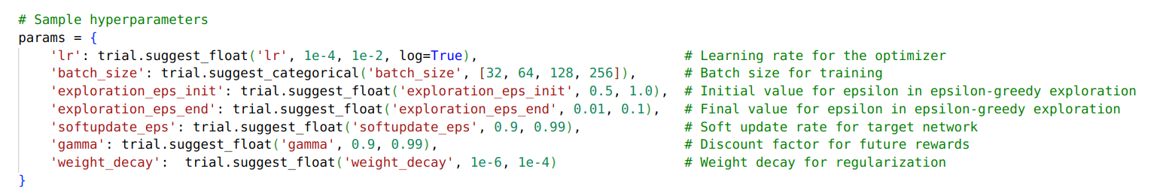
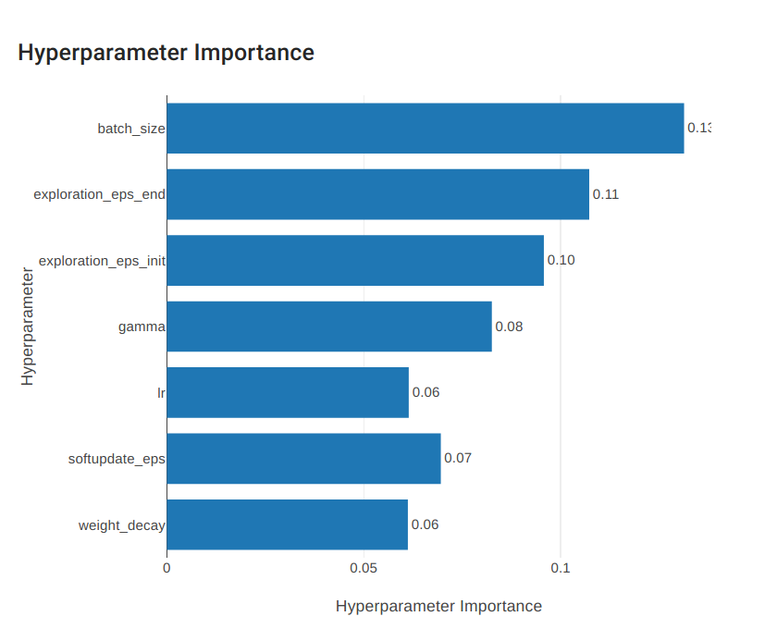
Optuna

Slide 17
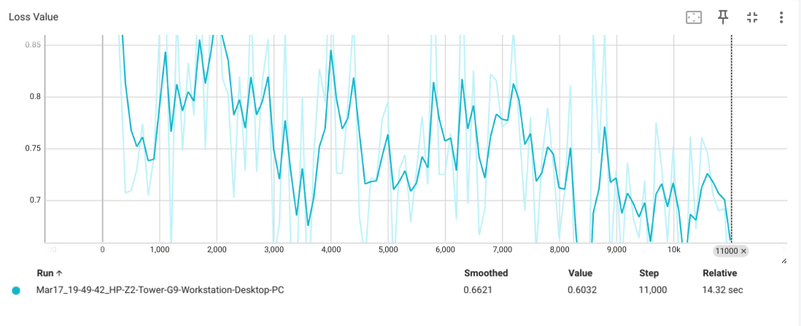
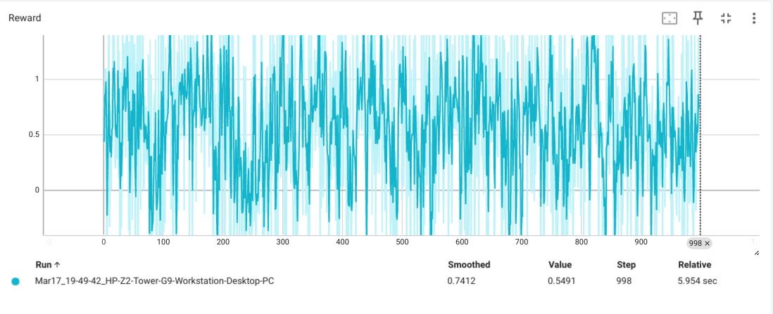
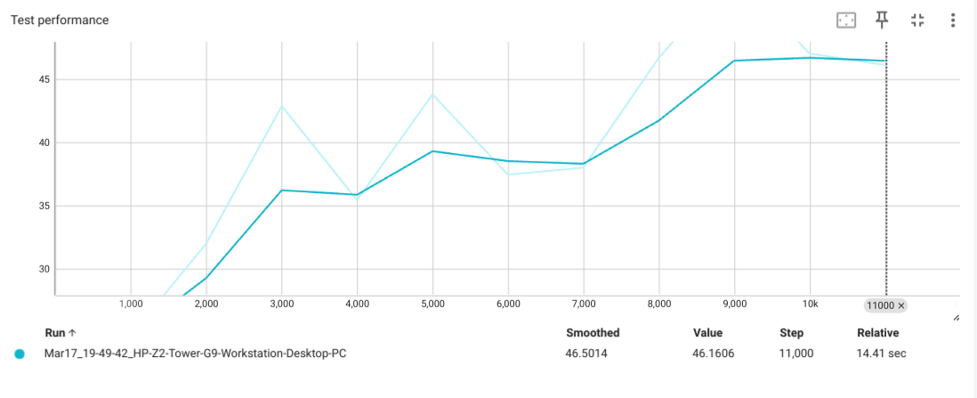
Tensorboard

Slide 18
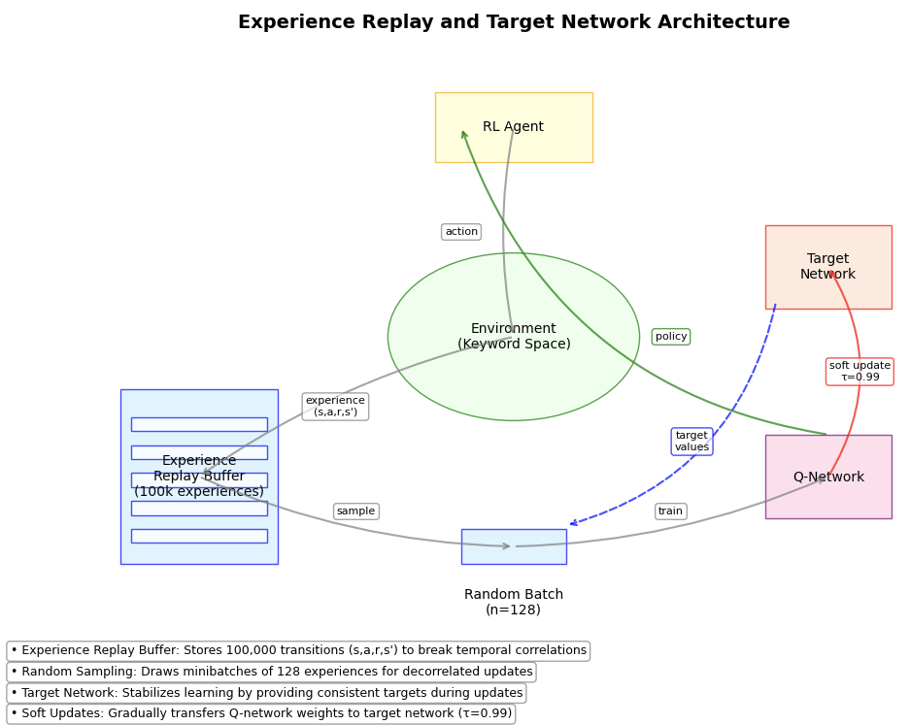
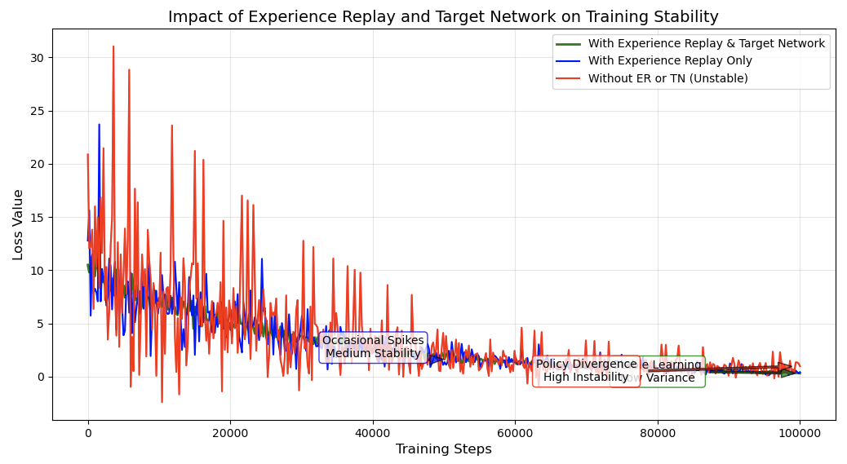
Data analysis (EO)
Notes:
The reinforcement learning network architecture has four main components: an RL Agent that interacts with the Environment (Keyword Space), an Experience Replay Buffer that stores 100,000 experiences, a Q-Network for learning, and a Target Network that stabilizes learning through soft updates (τ=0.99). The diagram shows how these components interconnect through actions, policies, and training processes.
To gain stability we need both the "Experience Replay + Target Network" (green line). The blue line (Experience Replay Only) shows medium stability with occasional spikes. The red line (without either technique) demonstrates high instability with frequent variance

Slide 19
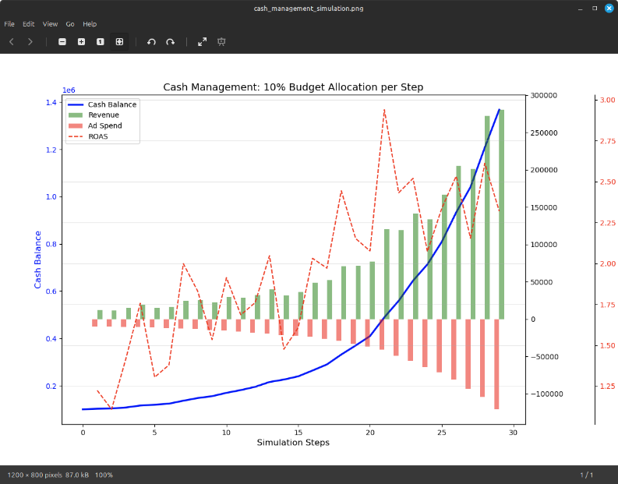
Cash Management Overview
Notes:
This plot shows the results of a reinforcement learning model managing advertising budget allocation. It demonstrates how cash balance (blue line) grows as the agent learns to select keywords with higher ROAS (red dashed line). Over time, ad spend (red bars) increases but generates proportionally higher revenue (green bars), indicating the model successfully learns to maximize return on advertising spend.

Slide 20
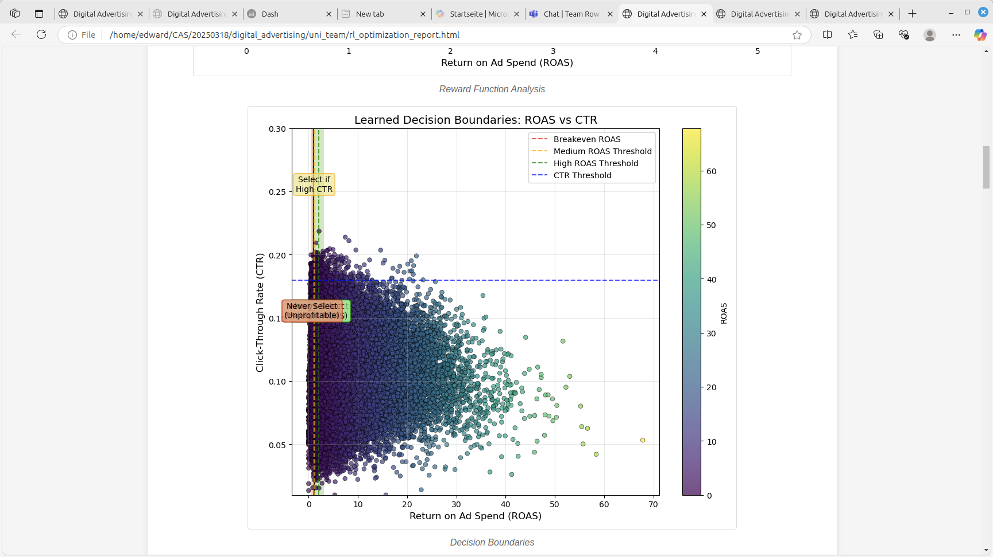
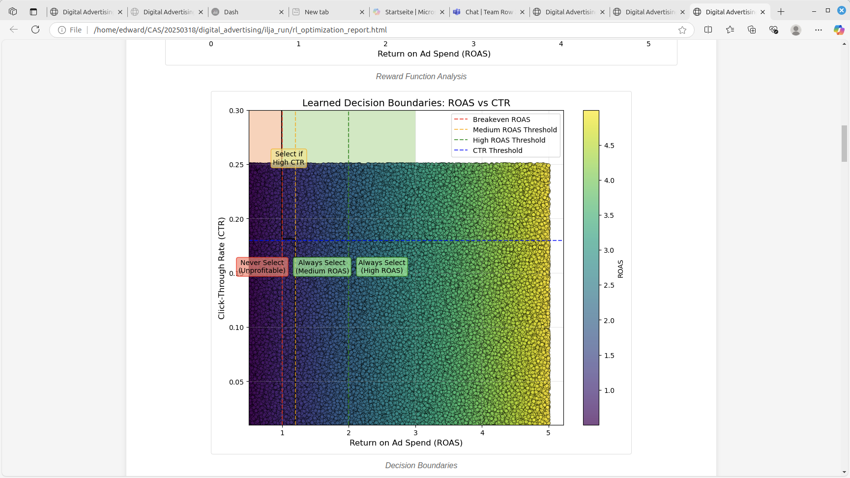
Comparison: Our data vs "Ilja simple data"
Notes:
This scatter plot shows the relationship between ROAS (Return on Ad Spend) and CTR (Click-Through Rate) with decision boundaries learned by the reinforcement learning model. Each point represents a keyword, colored by its ROAS value. The model has learned to select keywords with high CTR above the blue threshold when they exceed the green ROAS threshold, while avoiding unprofitable keywords below the breakeven line.

Slide 21
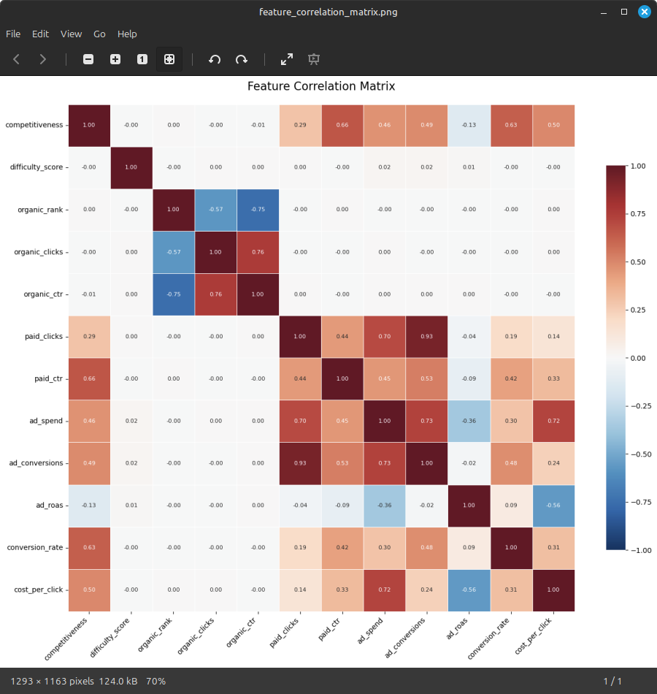
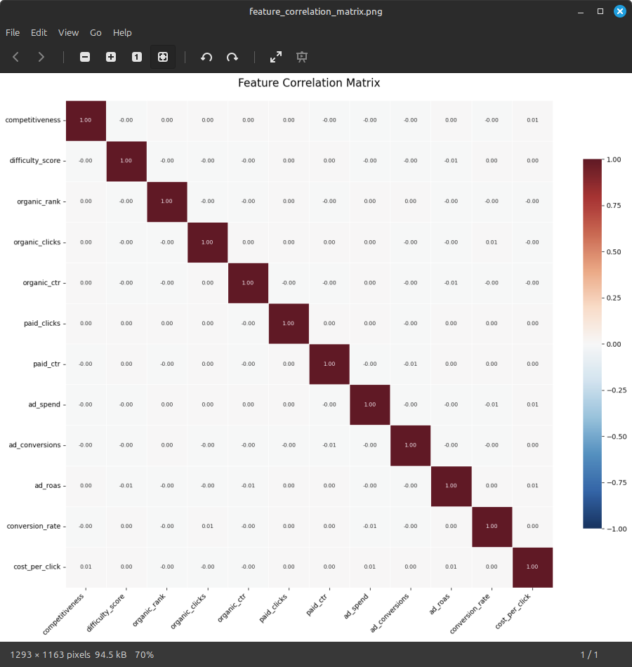
Comparison: Our data vs "Ilja simple data"
Notes:
The first correlation matrix (our data) shows strong relationships between advertising metrics in the actual dataset. Key correlations include paid_clicks with ad_conversions (0.93), organic_ctr with organic_clicks (0.76), and competitiveness with paid_ctr (0.66).
The second matrix displays virtually no correlations (mostly 0.00 values), as it's from randomized data. This comparison reveals that the reinforcement learning algorithm works with real-world data containing meaningful patterns, rather than random noise, enabling it to learn effective advertising strategies based on these interdependent variables.

Slide 22
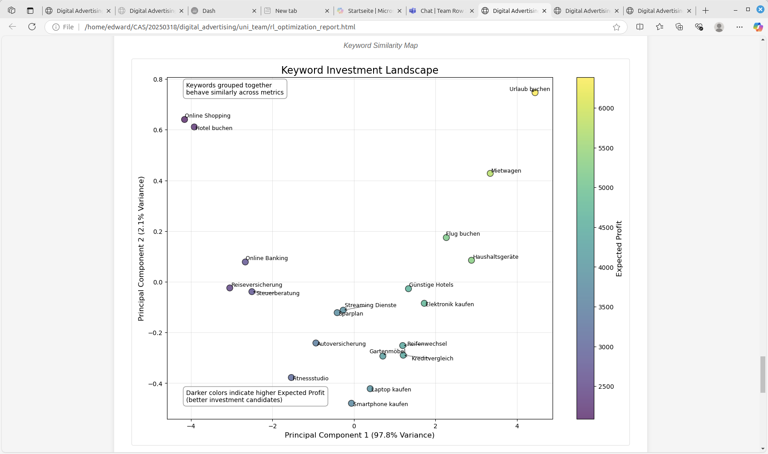
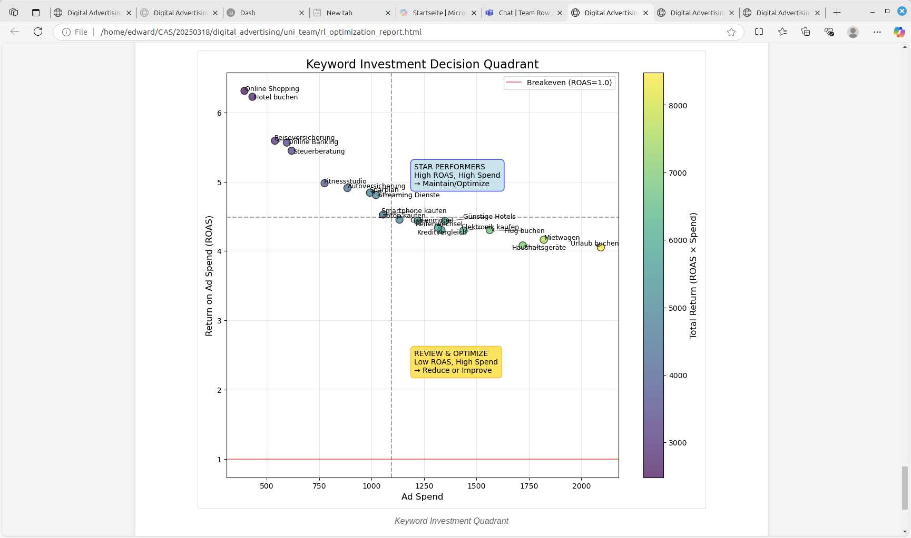
Which keywords to invest in?
Notes:
The first plot shows a PCA visualization of keywords, with 97.8% of variance explained by the first component. Keywords like "Urlaub buchen" have higher expected profit (yellow).
The second plot presents a decision quadrant mapping keywords by ROAS vs. Ad Spend. It identifies "star performers" (high ROAS, high spend) like financial services keywords that should be maintained, while highlighting which keywords need optimization. This strategic visualization helps the RL agent prioritize which keywords to invest in for maximum return. The digital advertising reinforcement learning model optimizes keyword selection by analyzing ROAS and other metrics. Combining Experience Replay with Target Network provides superior training stability, resulting in exponential cash balance growth. The model establishes clear decision boundaries for keyword selection and categorizes keywords into performance quadrants. PCA analysis reveals natural keyword clustering with German travel terms like "Urlaub buchen" showing highest profitability. The approach automates advertising decisions, maximizes ROI through strategic budget allocation, and recognizes meaningful data patterns. Implementation uses TorchRL with a custom environment, DQN architecture, and epsilon-greedy exploration, demonstrating strong potential for automated advertising optimization.

Slide 23
Lessons Learned / Herausforderungen (MAC)
Erfahrungen in einem „realen“ Business-Projekt → von der Idee via Daten und Training zur Analyse
Daten: Gewisse offene Fragen hinsichtlich Datenqualität
TorchRL Library
Fehlendes Knowhow über "Digital Advertising" aufgebaut

Slide 24
GitHub- / Colab-Link
Digital Advertising «Gruppe 2» on GitHub
Colab-Notebook

